Slide 1
Analyzing Market Dynamics and Revitalizing Brand Strategy for Market Cannibalization of an Injectable Anesthesia Drug
Hima Pragnya Jonnalagadda

Slide 2
PROBLEM STATEMENT
Analyzing Market Dynamics and Revitalizing Brand Strategy for Market Cannibalization of an Injectable Anesthesia Drug
BUSINESS SOLUTION
Identify data-driven observations on the performance of each product and derive the actionable business recommendations for the sales and marketing team to gain market share for Midoride (Variant).
BUSINESS IMPACT
This solution will
Enhance Midoride's market share
Support strategic initiatives for the Sales & Marketing unit
Boost sales resulting in increased revenue.
Executive Summary

Slide 3

PROBLEM STATEMENT
The Problem in hand involves a significant decline in sales for our variant brand. This decline coincides with the growing market share of competitor brands.
Our strategic goal is to drive growth for the variant product
We aim to perform a comprehensive analysis of the anesthesia drug market, including an examination of market share trends, growth rates, and external factors like the Territories affecting the market.

Slide 4
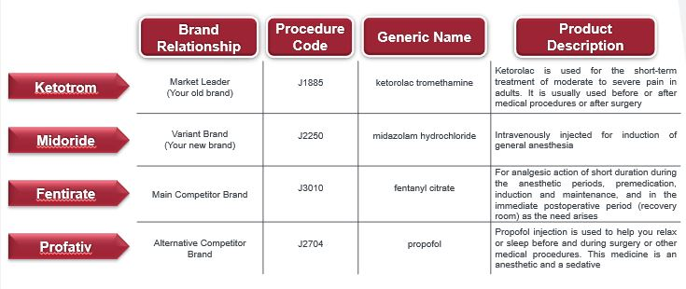
MARKET BASKET

Slide 5
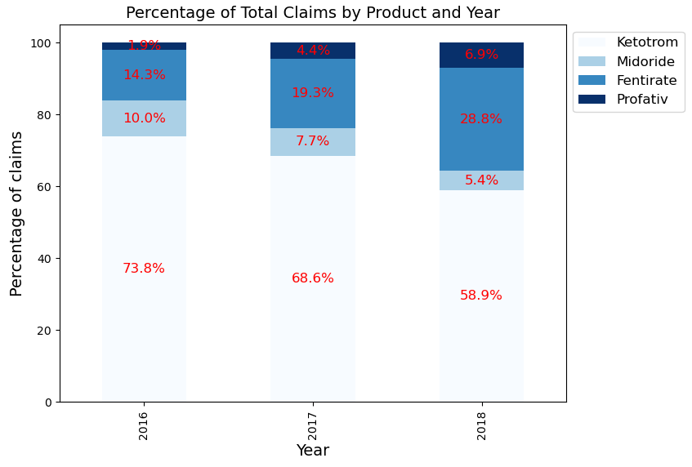
Fentirate, the competitor, boosted sales by 50% with a significant decrease in Midoride, the variant.
Observations - ​
​
Dominant Product: Ketotrom - proportion decreases over time from 73.8% in 2016 to 58.9% in 2018.
Declining Product: Midoride - shows a declining trend in their percentage of total claims. A sharp drop from 10% in 2016 to 5.% in 2018.
Growing Product: Fentirate – Stable claim percentages with an increase of 50% from 2016 – 2018.
Expanding Product: Profative – Consistent increase in usage of the product

Slide 6
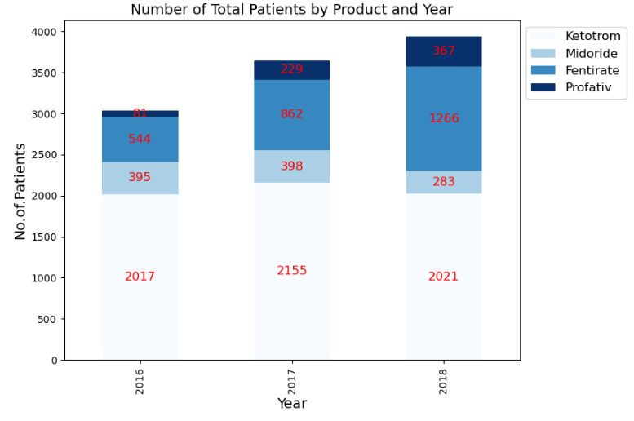
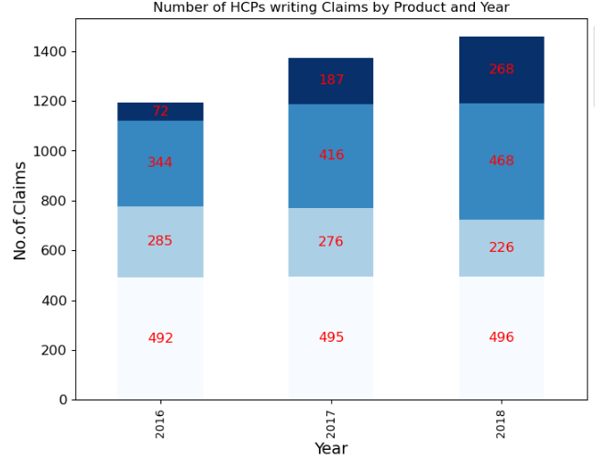
Patients claiming Fentirate & Profative increased by 3.5x with a notable decrease in claims for Midoride by 2.5x
By 2018, the number of HCPs prescribing Midoride and Ketotram remained stable, whereas the number of HCPs prescribing Fentirate increased significantly.

Slide 7
Actionable Recommendations - I
Identify why HCPs prescribing the competitor brand accelerated?
Target the Prescribers of the competitor brand.
To improve patient claims, evaluate the pricing strategy – Offer discounts, patients assistance programs.
To make HCPs prescribe – Share the results of clinical trials and demonstrate the safety and efficacy of Midoride.
Increase promotional efforts – Medical conferences and publications.

Slide 8
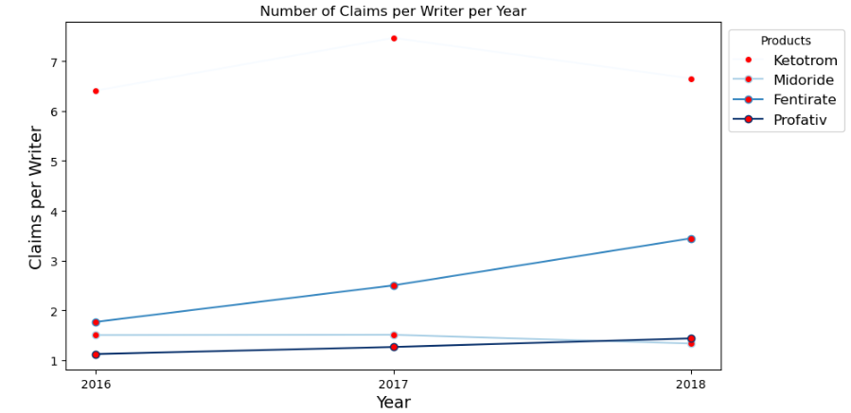
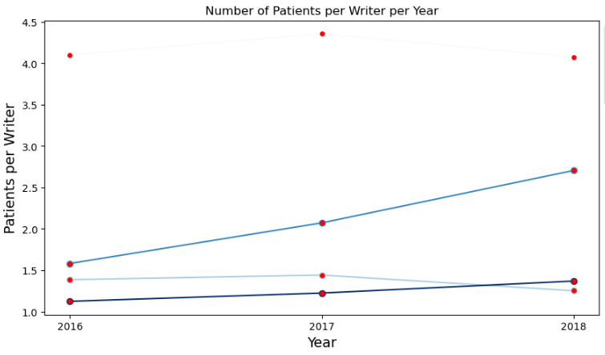
Decline in HCPs writing claims and patients per HCP for Midoride and Ketotram in 2017-18, while there was a concurrent increase for competitor brands.
Observations - ​
Midoride is a high considerable product for HCPs in 2018.
Slightly reduced prescriptions and patients per HCP for Midoride in 2018.
Increased Prescription and patient rate per HCP for the competitor products from 2017- 2018
​

Slide 9
Actionable Recommendations - II
Segmentation of HCP by performance –
1. Worst performing HCP (writing less no. Of. prescriptions) and
2. Best Performing HCP (writing more no. Of. prescriptions)
Target the Best performing HCP of the competitor brand, sales team to make personal appointments and explain – Provide samples.
Map the sales rep to the respective speciality – Highlight the benefits of Medoride for that sepciality.
Focus on HCPs who are high prescribers of Ketotrom to start prescribing Midoride for injectibe anesthesia.

Slide 10
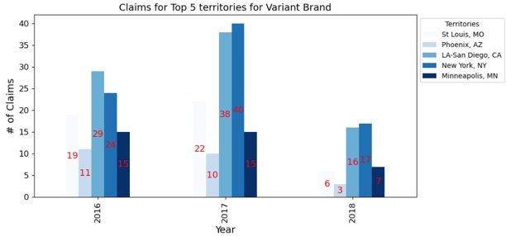
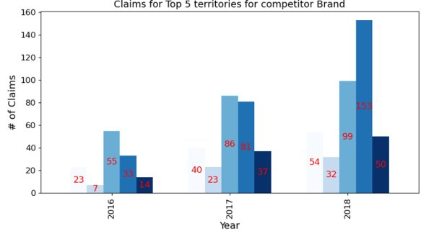
The most significant decline in Variant was observed in St. Louis and LA-San Diego, accompanied by a notable shift in market share towards the competitor in New York.
Observations (Variant) -
The Year-over-Year change shows a significant decline in the claims for the variant (2017 – 2018)
Observations (Competitor) -
New York captured a significant new market or more effectively expanding its prescriber base. (Claims increased more than double)

Slide 11
Actionable Recommendations - III
In highly populated territories(NY), with more HCPs - on broad-reaching initiatives, such as mass media campaigns, larger-scale HCP engagement programs.
Participate in conferences, and collaborate on initiatives that align with your Midoride's offerings.
In less populated territories, tailor message efficiently to HCP personally and conduct small-scale events.
Motivate salesforce with incentives.

Slide 12
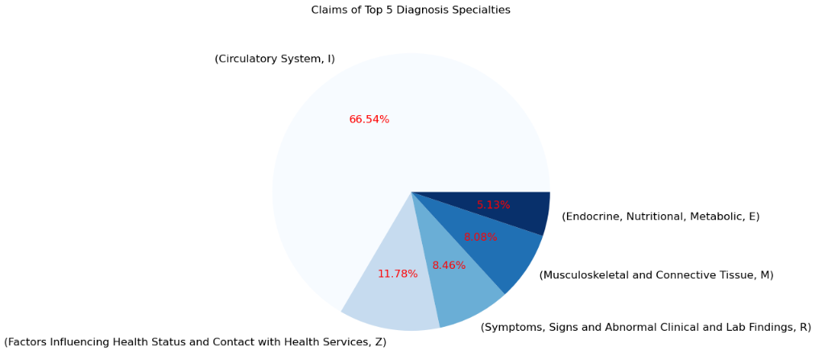
Every 2 out of 3 claims is attributed to the Circulatory system specialty.
Observations :
Circulatory System related claims have the largest percentage of claims
Diagnosis Code
Notes:
The majority of claims, accounting for more than 66%, are

Slide 13
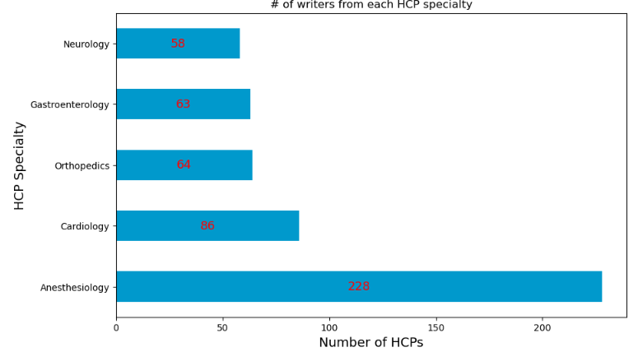
The majority of claims, 228 HCPs in total, come from the Anesthesiology specialty, while Cardiology is identified as the growing specialty, with 86 HCPs making claims.
Observation :
Medically critical patients prefer Injectable anesthesia

Slide 14
Actionable Recommendations - IV
Target anesthesiologists of the circulatory system speciality
Assign sales team members with expertise in cardiac diseases to effectively communicate the advantages of Midoride in this field.

Slide 15
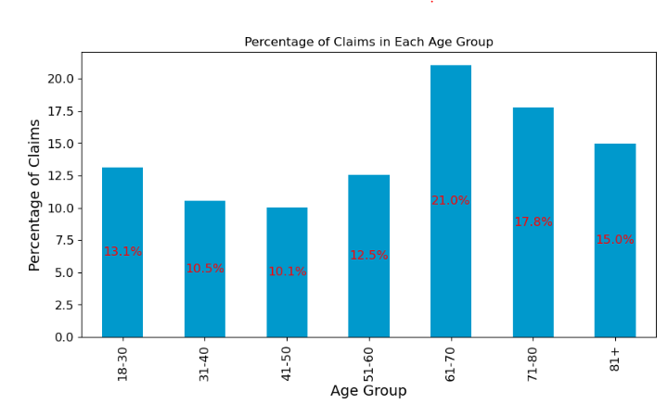
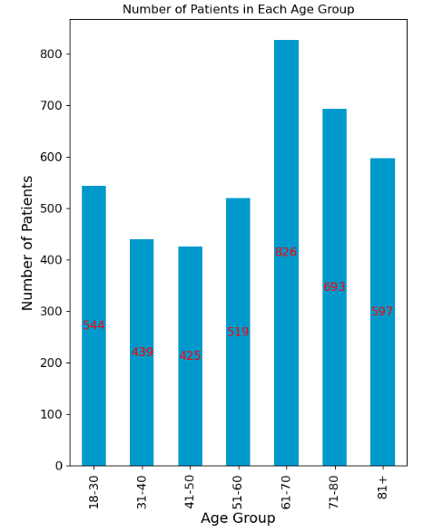
The majority of claims are made by patients above 60 years, with the age group 18-30 years identified as the growing segment.
Actionable recommendations V -
Patients above 60 years are most likely to have injectable anesthesia procedures – Explain HCPs
18-30 age group are also growing in claiming anesthesia products – recommend HCPs to use Midoride for this age group

Slide 16
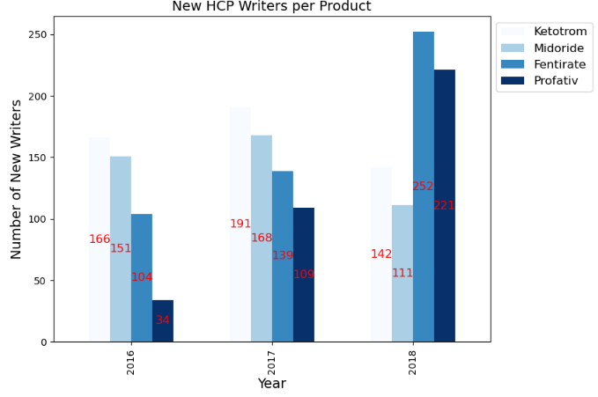
New Writer Trends: Stable Growth in 2016-2017, Shifts in 2018
Observations - ​
There has been a 140% increase in new HCP writers for Fentirate from 2016-2018
The number of new writers for all products exhibited a steady increase from 2016 to 2017.
However, in 2018, there was a noticeable decline in new prescriptions for Ketotram and Medoride, accompanied by a substantial increase in new prescriptions for Fentirate and Profativ.
​

Slide 17
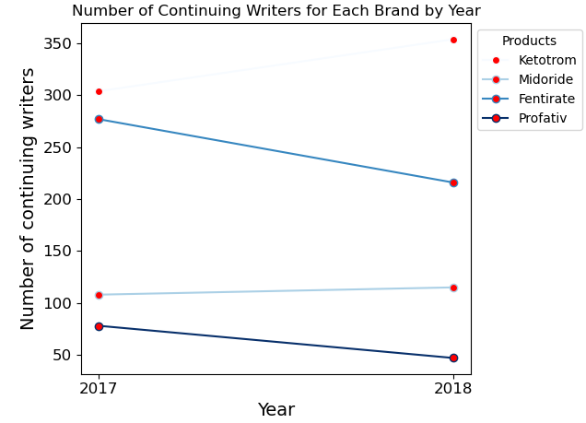
Stability in Continuing HCP Writers for Ketotram and Midoride, Decrease for Fentirate and Profative by 2.3x
Observations -
Continuing HCP writers remained relatively stable for Ketrotram and Midoride.
On the other hand, the continuing writers for Fentirate and Profative decreased by 2.3x
Actionable Recommendations-
Identify the new writers of the competitor brand and attract them to use Midoride - highlight the performance of Ketotram and Midoride comparitively with competitors in 2016-2017.
To increase Midoride writers, Make the continuing HCPs write more Claims - offer them incentives to continue using Midoride. For example, manufacturers could offer discounts on bulk purchases or provide free samples.

Slide 18
Concluded recommendations
Strategical HCP targeting – Meet worst performing HCPs and those writing for competitor brand. Share results of clinical trials demonstrating the safety and efficacy of Midoride. Provide samples. Email to Best HCPs to continue writing more Rx.
Increase the availability of samples to anesthesiologists (Especially cardiology speciality), as this could encourage trial among those who have not prescribed the variant brand.
In large territories like New York with large population, conduct mass media campaigns and medical conferences to highlight Midoride's benefits and offerings.

